Slide 1

CGAL
The Computational Geometry Algorithms Library
Miquel Gotanegra
Notes:
Hello, I’m Miquel Gotanegra and I will be doing a quick overview on some of the features CGAL has to offer

Slide 2
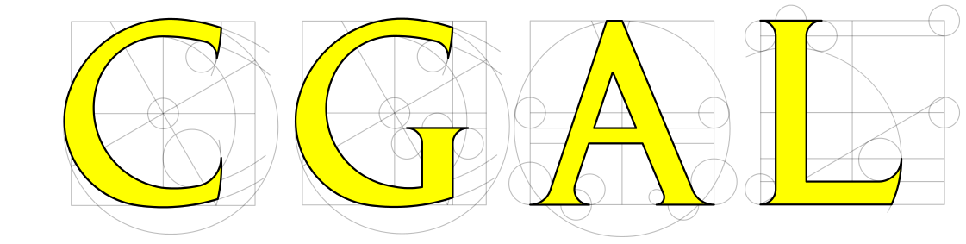
What’s CGAL
The Computational Geometry Algorithms Library (CGAL) is an open source C++ software library of computational geometry algorithms, that offers a wide array of classes to help tackle different types of geometrical problems.
CGAL is used in various areas needing geometric computation, such as geographic information systems, computer aided design, molecular biology, medical imaging, computer graphics, and robotics.
Even though CGAL is written in C++, thanks to Scilab bindings you can use the library in Python (cgal-bindings) and Java (SFCGAL)
Notes:
The COMPUTATION GEOMETRY ALGORITHMS LIBRARY or CGAL in short, is an open-source C++ library of geometry algorithms that offers a wide array of classes to help tackle different types of geometrical problems.
CGAL is used in various areas needing geometric computation, such as geographic information systems, medical imaging, etc.
Even though CGAL is written in C++, thanks to Scilab bindings you can us the library in Python and Java, although this versions may not be up to date with the C++ version

Slide 3
CGAL packages
Arithmetic and Algebra
Combinational Algorithms
Geometry Kernels
Convex Hull Algorithms
Polygons
Cell Complexes and Polyhedra
Arrangements
Triangulations and Delaunay Triangulations
Voronoi Diagrams
Mesh Generation
Shape Reconstruction
Geometry Preprocessing
Spatial Searching
Geometric Optimization
Interpolation
Support Library
Visualization
Notes:
Here we can see all the topics covered in the CGAL library. We can see that the library is not bound to a particular topic and is fairly complete, and most of these packages offer both 2D and 3D implementations of the algorithms

Slide 4
Useful classes for this course
Notes:
4
Here I picked three of the classes that I think would be useful for this course, but there are many many more

Slide 5
Useful classes for this course
2D triangulation
Notes:
2D triangulation
This package allows to build and handle various triangulations for point sets two dimensions. All triangulation covers the convex hull of its vertices. Triangulations are built incrementally and can be modified by insertion or removal of vertices. They offer point location facilities. The package provides plain triangulation (whose faces depend on the insertion order of the vertices) and Delaunay triangulations.
for computing particular extreme points and subsequences of hull points, such as the lower and upper hull of a set of points.

Slide 6
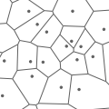
Useful classes for this course
2D triangulation
2D Voronoi Diagram Adaptor
Notes:
2D Voronoi Diagram Adaptor
this classes provides an adaptor to transform a 2D Delaunay triangulation into a Voronoi diagram, represented on DCEL data structure

Slide 7
Useful classes for this course
2D triangulation
2D Voronoi Diagram Adaptor
2D Convex Hulls and Extreme Points
Notes:
2D Convex Hulls and Extreme Points
This package provides functions for computing convex hulls in two dimensions as well as functions for checking if sets of points are strongly convex are not. There are also a number of functions described for computing particular extreme points and subsequences of hull points, such as the lower and upper hull of a set of points.

Slide 8
How to use CGAL
Installing the library
# Debian, Ubuntu, Linux Mint, ...
sudo apt-get install libcgal-dev
Including one kernel. The kernel provides types, construction objects, and generalized predicates that CGAL will use, like the implementation of points, how their arithmetic works and even the equality operator.
#include <CGAL/Cartesian.h>
or
#include <CGAL/Exact_predicates_inexact_constructions_kernel.h>
Including the classes you will use. I recommend using some typedefs to shorten the calls.
#include <CGAL/Triangulation_2.h>
typedef CGAL::Exact_predicates_inexact_constructions_kernel K;
typedef CGAL::Triangulation_2<K> Triangulation;
typedef Triangulation::Point Triangulación;
Notes:
How to use CGAL?
As said before, CGAL is a C++ library. To install it we can use a library manager from the console
Once installed, on the cpp main file we have to include a kernel. The kernel provides types, construction objects, and generalized predicates that CGAL will use, like the implementation of points, how their arithmetic works and even the equality operator.
Depending on the kernel we use we can increase speed/precision of our program, we will see a a bit of this later on the presentation
Then you just Import the clases you need as you would do with any other c++ library

Slide 9
Why should you use CGAL?
ROBUSTNESS
Notes:
Why should you use CGAL?
Well, besides being an enormous library with extensive documentation an all of his classes , CGAL offers on of the key elements of geometrical computation
ROBUSTNESS

Slide 10
Robustness issues
Careless use of floating point arithmetic can cause a geometric algorithm to produce wrong output or even get stuck in an infinite loop.
There is a gap between geometry on theory and geometry using floating-point arithmetic.
That’s due to the nature of how doubles, as they can only store up to 15 digits, anything below that gets lost. (It may not seem much like, but the error adds up when we start to multiplying and dividing between points).

Slide 11
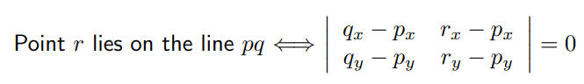
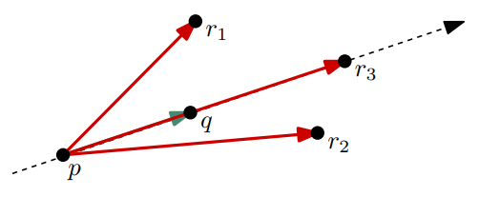
Robustness issues
Since most algorithms’ correctness rely on geometrical theorems, getting those wrong means our code may not get the expected result.
Take for instance the orientation test:
We know that if the determinant is 0, the point is ALWAYS on the line, but that may not be true when using doubles. Making this assumption may lead to a invalid result.

Slide 12
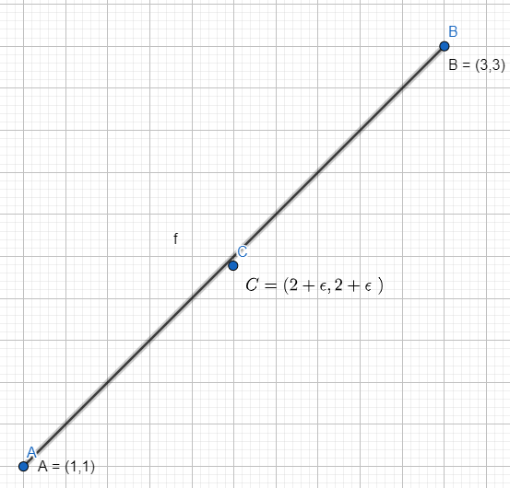
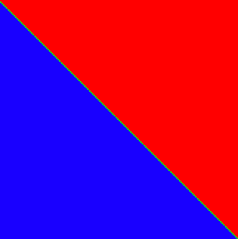
Theorical geometry
Orientation test
positive zero negative
C is NOT on the line
Notes:
In Theorical geometry we have that the determinant of a segment and a line is always positive if the point is to the left of the line, 0 if its on the line and negative if its to the right
We can see on the left image the representation of of the theorical determinats.
In this case C is NOT on the line

Slide 13
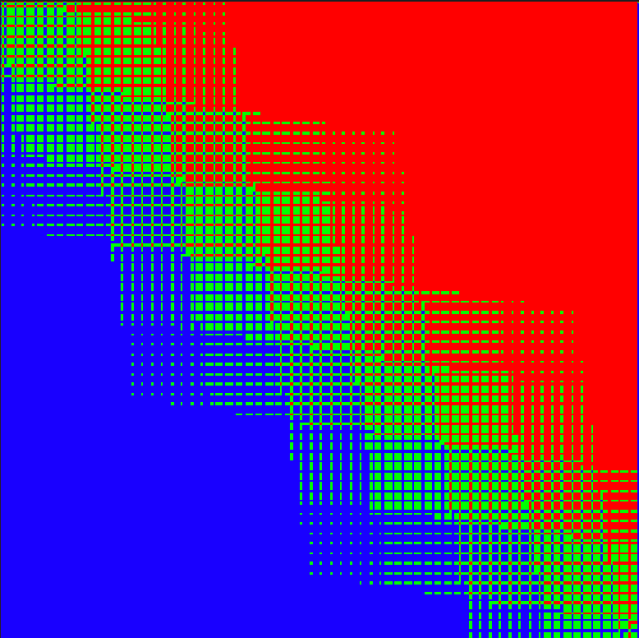
Float-point geometry
Orientation test
*close up
positive zero negative
C may or may not be on the line
Notes:
But when using floating point arithmetic, the determinant may or may not return the correct output. Depending on how small epsilon may be, the function may say that C is on the line, as we see on the picture, it may even return that C is in the wrong side on the line

Slide 14
How CGAL solves this
Exact Geometry computation
As shown before, CGAL can use different types of kernels. For instance, the Cartesian kernel handles the data using float point arithmetic. This kernel is fast, but we’ve seen that the results are not always accurate.
That’s when the other types of kernels come to light, Exact_predicates_inexact_constructions_kernel.
Those kernels are based on the principle that exact predicates are robust. (Exact predicates are statements that you know for sure). “In CGAL, we write the high-level algorithms in terms of a well-chosen set of basic questions (where is a point with respect to a line?) and basic objects (like a circle through three points) Doing this in the right way is not always easy, but once it is done, we have outsourced all the numerical issues, and we only have to make sure that the part of CGAL concerned with the basics returns correct results” *.
* CGAL website on The Exact Computation Paradigm

Slide 15
How CGAL solves this
Exact Geometry computation
As shown before, CGAL can use different types of kernels. For instance, the Cartesian kernel handles the data using float point arithmetic. This kernel is fast, but we’ve seen that the results are not always accurate.
That’s when the other types of kernels come to light, Exact_predicates_inexact_constructions_kernel.
Those kernels are based on the principle that exact predicates are robust. (Exact predicates are statements that you know for sure). “In CGAL, we write the high-level algorithms in terms of a well-chosen set of basic questions (where is a point with respect to a line?) and basic objects (like a circle through three points) Doing this in the right way is not always easy, but once it is done, we have outsourced all the numerical issues, and we only have to make sure that the part of CGAL concerned with the basics returns correct results” *.
* CGAL website on The Exact Computation Paradigm

Slide 16
How CGAL solves this
Exact Geometry computation
As shown before, CGAL can use different types of kernels. For instance, the Cartesian kernel handles the data using float point arithmetic. This kernel is fast, but we’ve seen that the results are not always accurate.
That’s when the other types of kernels come to light, Exact_predicates_inexact_constructions_kernel.
Those kernels are based on the principle that exact predicates are robust. (Exact predicates are statements that you know for sure). “In CGAL, we write the high-level algorithms in terms of a well-chosen set of basic questions (where is a point with respect to a line?) and basic objects (like a circle through three points) Doing this in the right way is not always easy, but once it is done, we have outsourced all the numerical issues, and we only have to make sure that the part of CGAL concerned with the basics returns correct results” *.
* CGAL website on The Exact Computation Paradigm

Slide 17
How CGAL solves this
Exact Geometry computation
To ensure predicates correctness, CGAL uses different tools:
multiple precision rational, floating point and algebraic numbers (single numbers stored on vectors to provide much higher precision)
interval arithmetic (compute upper and lower bound for variables)
static analysis of roundoff-error propagation
How predicates work
Filtered_predicate<predicate>
Tries the predicate instantiated within the intervals
In case of uncertainty, increase the precision of the predicate using multiple precision arithmetic
Performance boosts
Using static error analysis
Increasing precision progressively using filters, instead of jumping directly to the highest precision

Slide 18
How CGAL solves this
Exact Geometry computation
To ensure predicates correctness, CGAL uses different tools:
multiple precision rational, floating point and algebraic numbers (single numbers stored on vectors to provide much higher precision)
interval arithmetic (compute upper and lower bound for variables)
static analysis of roundoff-error propagation
How predicates work
Filtered_predicate<predicate>
Tries the predicate instantiated within the intervals
In case of uncertainty, increase the precision of the predicate using multiple precision arithmetic
Performance boosts
Using static error analysis
Increasing precision progressively using filters, instead of jumping directly to the highest precision

Slide 19
How CGAL solves this
Exact Geometry computation
To ensure predicates correctness, CGAL uses different tools:
multiple precision rational, floating point and algebraic numbers (single numbers stored on vectors to provide much higher precision)
interval arithmetic (compute upper and lower bound for variables)
static analysis of roundoff-error propagation
How predicates work
Filtered_predicate<predicate>
Tries the predicate instantiated within the intervals
In case of uncertainty, increase the precision of the predicate using multiple precision arithmetic
Performance boosts
Using static error analysis
Increasing precision progressively using filters, instead of jumping directly to the highest precision

Slide 20
Source: yt->CGAL: The Open Source Computational Geometry Algorithms Library
3D Delaunay of 1M random points
KERNEL | time
Doubles | 13s
Multiprecision numbers | 830s
Interval arithmetic + rational numbers | 63s
Interval arithmetic + rational numbers + static filter | 16s

Slide 21
THANKS

Slide 22
REFERENCES
CGAL: The Open Source Computational Geometry Algorithms Library
CGAL website
Exact Predicates on JS

